Slide 1
Random Forest
Why it is better than decision tree

Slide 2
How do decision trees work?
For data with continuous values:
1. For each feature, get unique values, sort in ascending order, get the split points between each data point
Outcome y:
109 | 292 | 330 | 82 | 298 | 439 | 771 | 882 | 75 | 512
Feature array X:
55 | 23 | 77 | 9 | 23 | 96 | 36 | 55 | 8 | 102
Unique and sorted:
8 | 9 | 23 | 36 | 55 | 77 | 96 | 102
Split points:
8.5 | 16 | 29.5 | 45.5 | 66 | 86.5 | 99

Slide 3
How do decision trees work?
2. For every split point, divide y into two groups:
Split points:
8.5 | 16 | 29.5 | 45.5 | 66 | 86.5 | 99
Group 1: y for all x<split point
Outcome y:
109 | 292 | 330 | 82 | 298 | 439 | 771 | 882 | 75 | 512
Feature array:
55 | 23 | 77 | 9 | 23 | 96 | 36 | 55 | 8 | 102
Group 2: y for all x>=split point

Slide 4

How do decision trees work?
Split points:
8.5 | 16 | 29.5 | 45.5 | 66 | 86.5 | 99
3. Calculate the Mean Squared Error of each group and total MSE for that split point
Group 1: 292, 82, 298, 75
Group 1 MSE: (292-186.75)² + (82-186.75)² + (298-186.75)² + (75-186.75)²
Group 2: 109, 330, 439, 771, 882, 512
Group 2 MSE: (109-507.17)² + (330-507.17)² + (439-507.17)² + (771-507.17)² + (882-507.17)² +
(512-507.17)²
MSE for split point 29.5: (Group 1 MSE + Group 2 MSE)

Slide 5
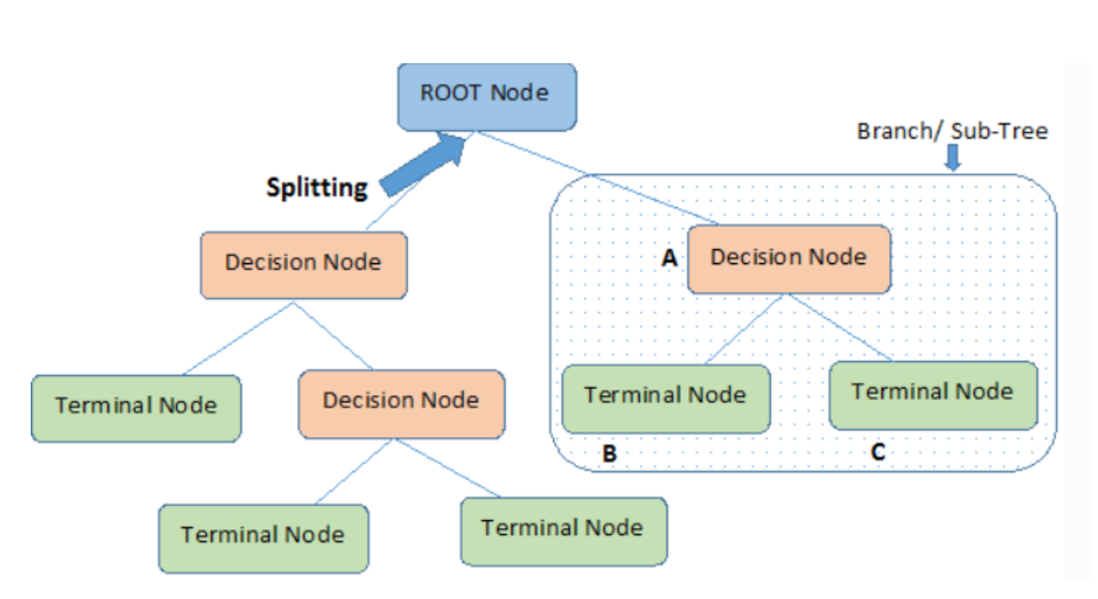
How do decision trees work?
4. Do this for every feature and every split point. Pick the feature and split point with the lowest SSR as the node splitting rule.
5. Repeat until you have reached a maximum depth, SSR of parent node is greater than child node, or if you have reached the minimum number of data points in a node. Node then becomes a leaf/terminal node.
Depth
Defines the minimum samples (or observations) required in a terminal node or leaf.

Slide 6
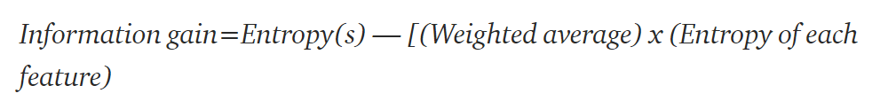
Splitting criterion
Gini Impurity: Choose feature with lowest Gini Impurity
Information Gain: Choose feature with highest Information Gain
Notes:
If in a dataset there are a total of 20 entries or rows, and 14 of them belongs to label 1 and 6 of them belongs to label 2, the entropy will be equal to:
= — P(label 1).log(P(label 1)) — P(label 2).log(P(label 2))
= — 14/20.log(14/20) — 6/20.log(6/20)
=0.880
The information gain is the decrease in the entropy after the dataset is split on the basis of an attribute
https://towardsdatascience.com/a-dive-into-decision-trees-a128923c9298

Slide 7
Decision Trees prone to overfitting
Various methods used to combat overfitting: Setting constraints on the tree size aka Tree Pruning.
But Random Forests also combat overfitting. Steps in a RF algorithm:
Bootstrap Aggregation or Bagging: Randomly select part of training data set, randomly select features to build decision tree from
Create decision tree
Repeat for n estimators/trees
To predict:
Traverse each tree and get predicted value
Mean of predicted value

